Slide 1
PES Technothon- 2016
Proposal Submission

Slide 2
Agenda
Problem Statement
Solution Proposed
Duration
Architecture of the Solution
Technology Used
Documentation repository
Benefit of this Solution
Demo
Challenges and Suggestions:
Learnings from this program
Team Members and Roles

Slide 3
Problem Statement
Problem Statement:
Below are the objectives considered for Automation.
Framework objectives:
Base library files created by implementing POM(Page Object Model) with a standard design
Engineers are exposed only to the implemented libraries and test scripts are created by just invoking the libraries
Standard of writing scripts and best practices should be followed through out the Framework i.e. use of loggers, Reporters, Data check points etc..
Automation test scripts separated from input data store (for example: XML, Excel files)
User don’t have to modify the scripts, only the data part has to be modified by user.
Considered all the positive and negative cases for writing scripts
Used enhanced Reporting tool for customized Report generation
Implemented emailable reports for Sanity & Regression
Used new feature for Recording video while script execution

Slide 4
Solution Proposed :
Solution Proposed :
Below are the details of solutions provided for Automation of Aynax.
Functional & Technical Specifications
Standard process in Production
Free from dependencies
Complete Coverage
Future Enhancements Support
Pass/Fail Criteria
Automating only possible Test scenarios(Both positive and Negative scenarios)
Emailable Extent Reports and TestNG reports

Slide 5
Duration
Duration
The time taken to create and execute the scripts is as follows:
Start date: 16th-May-2016
End date: 20th-June-2016

Slide 6
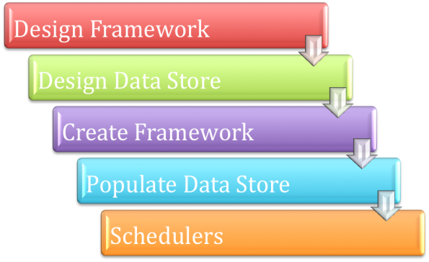
Architecture of the Solution
Identifying Requirements can be Automated
Actions to be performed - Identification of actions to be automated for each object of the application
Communicating Systems - Study of different internal systems, third-party systems and their communication methodology
Log - User-defined logs for analysis
Error Handlers - Error handlers to handle known and unknown errors and log the information
Custom Messages - Display of relevant defined messages
Result Presentation - Customized and presentable reports on completion of test execution

Slide 7
Technology Used
Technology & Tools being used
Selenium
Java
TestNG
Maven
Jenkins
AutoIT
Java mail API’s
Log4j
Screen Recorder API’s
GitHub
SVN

Slide 8
Documentation repository
Documentation repository: https://github.com/ReddyManjunath/AAT

Slide 9
Benefit of this Solution
Benefit of this Solution:
Built on open source tools / libraries / frameworks to reduce overall costs for company/customers
Avoid redundancy on test execution
Increases test coverage to enhance the quality and reliability of the end product
Enables quick updates and shorter learning curve due to our high interaction with Selenium user community
Robust, ﬂexible and extensible framework and support test automation on diverse sets of web applications across domains – Specially to Sales Domain application with removing only one layer from framework(Page object)
Reduced test data set-up time signiﬁcantly by using automation scripts
Reduced manual regression test effort by 66% to increase coverage of product areas
Facilitates better communication between various stakeholders and developers, using tables for representing tests and reporting their results
Reduces dependency on technically skilled resources
Automated HTML report generation and emailing of the same to all stake holders
Detailed test execution results with consolidated summary and error,logs,Videos
Support for sequential and concurrent execution on various browsers
Gives more re usability and less maintenance whenever changes in the Application & UI

Slide 10
Challenges and Suggestions
Application:
Understand the vast sales domain application and the domain quickly, without any proper artifacts
Consolidate veriﬁcation and validation activities to reduce dependency
Create a ﬂexible and scalable model in line with growing needs
Selenium:
Dealing with Mouse hover events, pop-up windows, Frames
No event trigger from value changes
Timeout resulting from synchronization problems
Document upload and Download
Customizing TestNG report into emailable & Sending mails using Microsoft Exchange Java service

Slide 11
Learnings from this program
Learnings from this program :
Team members learned about below Technology with Setup set up & Configuration:
Selenium WebDriver
Java
GitHub
AutoIt
Listeners
Customizing report, Loggers, Video recording
Mail sending Programmatically

Slide 12
Team Members and Roles
Team Members and Roles:
Manjunath Reddy – Team lead(Mentor)
Akshaya Kumar Panigrahi- Team member
Mallikarjuna Dakkipuram

